Slide 2
Ready for tomorrow… through Personalization
Personalization through
Blended Learning
1

Slide 3
Today’s Goal
to have a shared understanding of the term “Personalized Learning”
to continue to Personalize Education through Blended Learning
2

Slide 4
What is the Purpose?
We Personalize Learning to Maximize Individual Potential for all students
3

Slide 5
What is Personalization?
What is personalized for your students outside of education and how does this influence their expectations for learning?
Talk with the people around you about what Personalization means to you and what you already do in your classroom that helps you to Personalize Education for your students.
4

Slide 6
5

Slide 7
What is Personalization through Blended Learning?
Powtoon or YouTube
Based on Make Learning Personal by Bray and McClaskey
6

Slide 8
Personalized Learning means…
7

Slide 9
Personalized Learning means…
8

Slide 10
Personalized Learning means…
9

Slide 11
Personalized Learning means Learners…
Know how they learn best.
Are co-designers of the curriculum and the learning environment
Have flexible learning anytime and anywhere
Have a voice in and a choice about their learning
Have quality teachers who are partners in their learning
Use a competency-based model to demonstrate mastery
Self-direct their learning
Design their learning path for college and career
10

Slide 12
Personalization vs. Differentiation vs. Individualization
11

Slide 13
Personalization vs. Differentiation vs. Individualization
If you want more information about this topic, here is a link to a chart with more detail: http://www.personalizelearning.com/2013/03/new-personalization-vs-differentiation.html
12

Slide 14
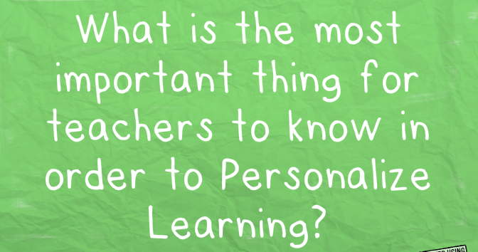
13

Slide 15
14
Notes:
Access- is about how a learner first processes information by accessing content through digital media, visual media, maybe through printed text, and sometimes through audio or touch. Ex: Explaining graphs and charts, hearing information, reading text online
Engage- describes how each learner engages with content and concepts using multiple strategies and tools that will keep his or her interest and encourage ownership of learning. EX: teaching others, collaborating etc.
Express- is how each learner expresses what they know and understand through actions, such as writing, acting presenting, building, drawing or sharing.

Slide 16
Kahoot Time!
In groups, answer the questions using your device.
15

Slide 17
16

Slide 18
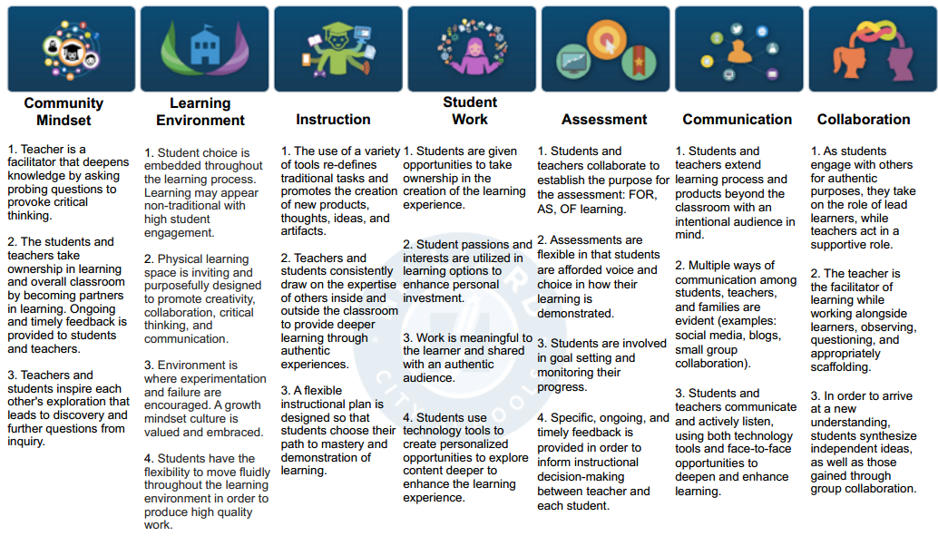
Blended Learning Look Fors
17

Slide 19
Changing the Classroom Culture
It takes a lot of thought and effort
It takes time to build up a clear picture of learners in your class and where they are in their own learning
It takes courage to stand back as a teacher and let the learning happen on its own accord
It requires a vision and belief that it will work
It needs careful planning, but still allow for change at a moment’s notice
It needs the voice of the learner to be listened to, to steer the direction of the learning
It needs you to rethink your approach to teaching and learning
18

Slide 20
Now it’s Your Turn!
You will be writing two SMART goals again this year. One of your goals should focus on one of the Blended Learning Look-For Characteristics. When you write this goal, be sure to write it through the lens of Personalization.
“What is the point of being alive if you don’t at least try to do something remarkable?”
– John Green
19

Slide 21
SMART Goals
S-pecific
M-easurable
A-ttainable and Achievable
R-esults-oriented
T-ime-bound
You will write two SMART Goals this year(one Professional and one Personal)
See the handout for more details
20

Slide 22
So What is Personalization through Blended Learning?
Powtoon or YouTube
21

Slide 23
Kahoot Time!
In groups, answer the questions using your device
22

Slide 24
23

